Slide 1


SoftUni
Quality Tech Education, Profession and Job for Thousands of Young People
SoftUni Team
Technical Trainers
Software University
https://softuni.bg

Slide 2
Have a Question?
sli.do #MathForDevs

Slide 3







SoftUni
Quality Digital Education for Thousands of Young People
3

Slide 4



SoftUni Initiatives
Digital Marketing
Design and Creative
Programming and Digital Skills for Kids
4

Slide 5


SoftUni Initiatives (2)
Private High School for Digital Skills
“Software University” Foundation

Slide 6
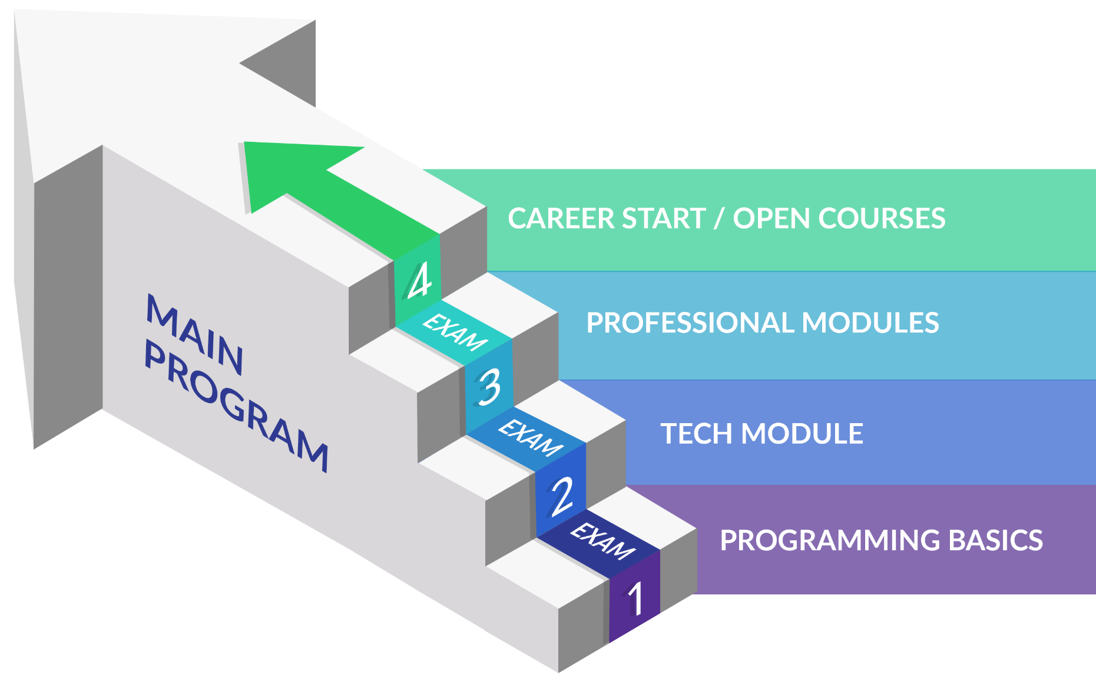
The Software Engineering Program
Professions: C# / Java / Python / JavaScript Developer
6

Slide 7
Open Courses @ SoftUni
Specialized trainings for IT and digital skills, open for everyone
Software Technologies: Angular, React, C++, Mobile Development
Data Science, Artificial Intelligence, Quality Assurance
Computer Networking, System Administration, Cyber Security, DevOps, Cloud
Electronics, IoT, Microcontrollers
Design, UX, Digital Art, Graphics, Multimedia, Video
Digital Marketing and Digital Business

Slide 8
Job for the Graduates
SoftUni helps students to start a job
Contracts with 70 + IT companies for hiring students from SoftUni
The top students will have the opportunity to work at SoftUni
The top students will choose between a lot of employers
We do not promise work for students with poor results
Career center
Seeks job for everyone with average success 5.00+

Slide 9
SoftUni
https://about.softuni.bg

Slide 10

For Administrative Question about Course
Email: university@softuni.bg

Slide 11












SoftUni Diamond Partners

Slide 12




SoftUni Organizational Partners

Slide 13





Trainings @ SoftUni
Software University – High-Quality Education, Profession and Job for Software Developers
softuni.bg
Software University Foundation
http://softuni.foundation
Software University @ Facebook
facebook.com/SoftwareUniversity
Software University Forums
forum.softuni.bg

